Slide 1

Where to find the fantastic esports companies:
from news to reality
—— Group 5 ——
Chau Fei Yeung 55624762
Fang Wei 55540007
Li Xiaozhuang 55386534
Jiang Yi 55386522

Slide 2
Introduction
CONTENT
Method
Result

Slide 3
01
Introduction

Slide 4

Introduction
In 2018, the 18th Asian Games in Indonesia made the esports a formal project for the first time. In November of the same year, Chinese team IG won the 2018 League of Legends World Championship.
With the rise and recognition of major events, esports is expected to cover a very large market size with a potential of growth.
A variety of esports companies have sprung up in various cities, launching different projects, which is driven by factors from politics, economy, technology etc. Meanwhile, diverse patterns of development in esports industry have shown in different cities.

Slide 5
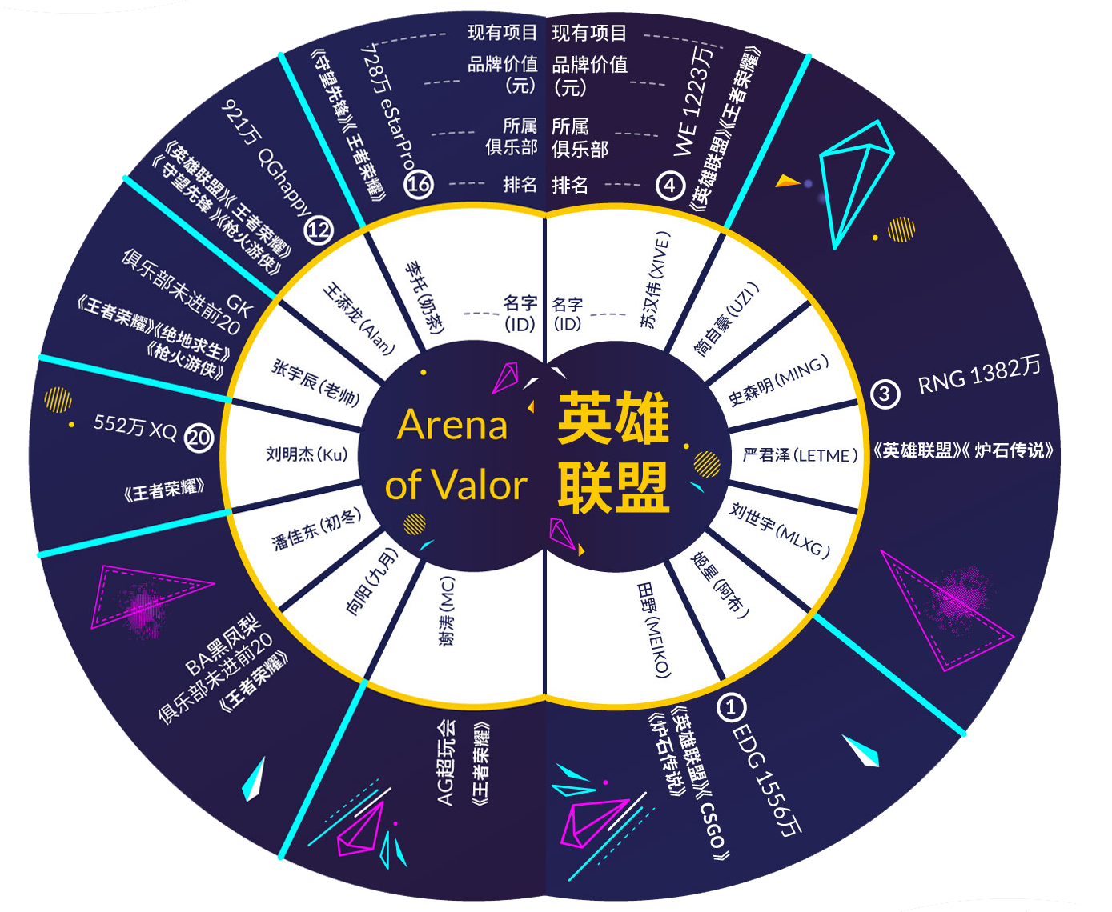
Any others’ similar work
1.Focus on esports players, teams and leading game companies.The main genres are feature stories and in-depth reports.
2.There are several industrial reports, including number of game players and revenue of big companies which has rare analysis on driven factors behind.
Source: Pengpai News

Slide 6

Research Questions
1.What is the development trend of China's esports-related companies?
2.What’s the region distribution of China’s e-sports-related companies?
3.How news reports esports in China? Are there difference between the reality and news？
4.What factors may relate to regional distribution differences of esports-related companies?

Slide 7
02
Method

Slide 8
Data Acquisition- Data source
1.List of e-sports companies in China
(1) Data Source
The reason of website selection: reasonable classification of variables; rich set of data
URL: 天眼查: https://www.tianyancha.com
(2) Measurements
Searching keywords: “电竞(e-sports)；
Crawling fields: “name”, “establishment time”, “registered capital”, “address”
2.News report: scrape news headlines
(1) Data Source
The reason of website selection: Chinese main news portal
URL: 新浪新闻: https://news.sina.com.cn/
(2) Measurements
Searching keywords: “电竞（e-sports）”, “电子竞技（e-sports）” ；
Crawling fields: headlines, date, source
3.Other Data:
(1) Average Network Speed:
Source: text report in PDF version from 2013-2016 China Broadband Rate Development Report
(2) City GDP:
Source: National Bureau of Statistics (http://data.stats.gov.cn/easyquery.htm?cn=E0105)
Notes:
•(The data acquisition process)
•Data source
–The reason of case (website) selection：
–all the URLs you scraped
•Measurements or variables
–Which areas do you want to scrape?
–What are the variables you are targeting at?
–(optional) Make a screen snapshot of the targeted webpages and “inspecting the element” window (as in Assignment #01).

Slide 9

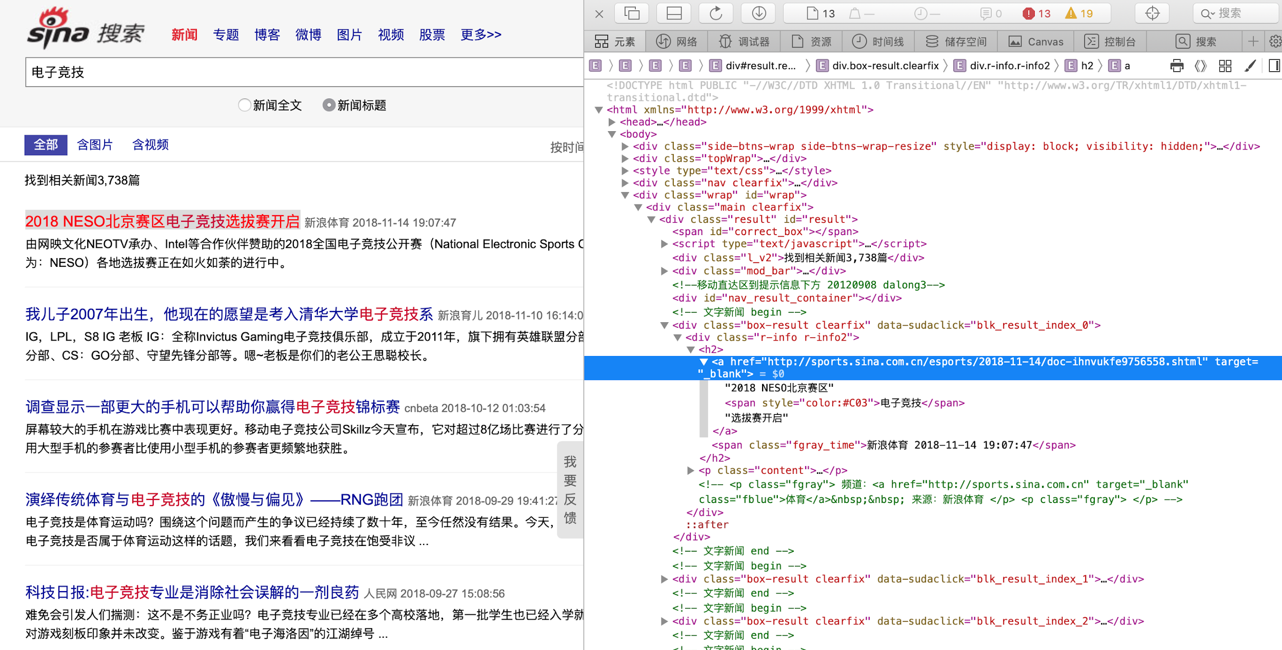
Data Acquisition

Slide 10
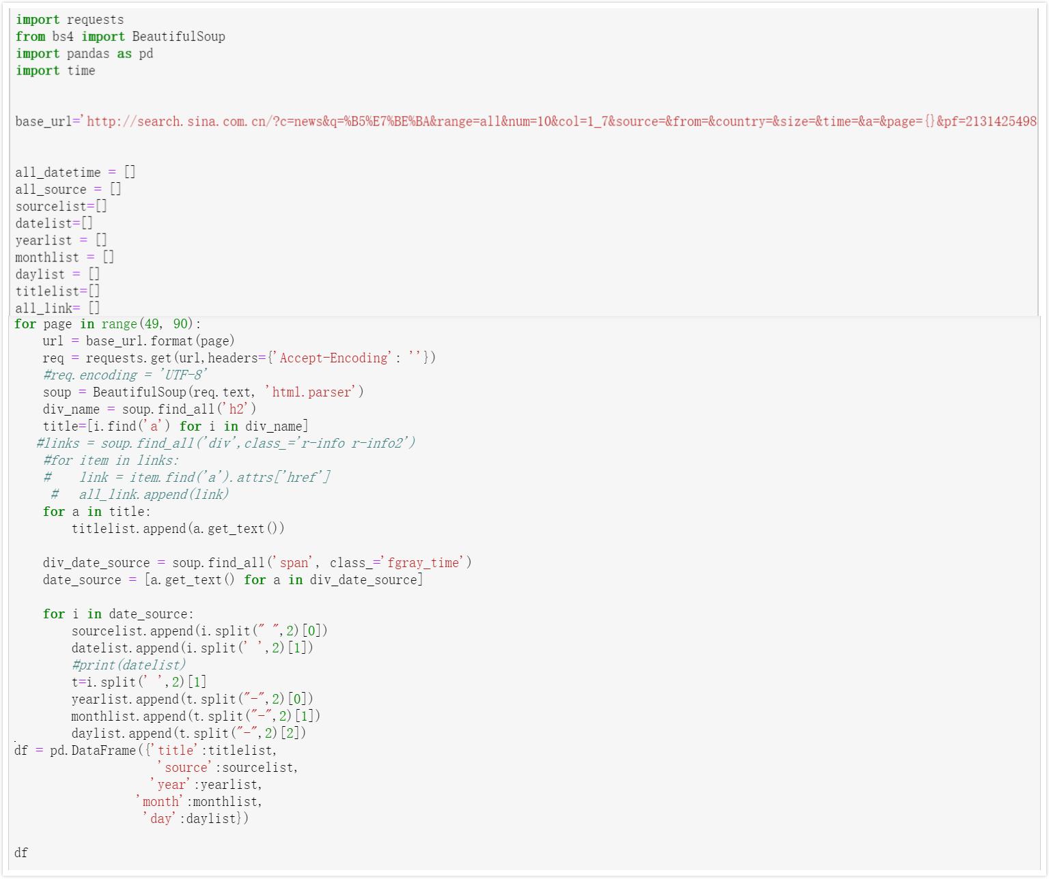
Data Acquisition
1.Page loop：
http://search.sina.com.cn/?c=news&q=%B5%E7%BE%BA&range=all&num=10&col=1_7&source=&from=&country=&size=&time=&a=&page={}&pf=2131425498&ps=2132080888&dpc=1
2.Split date and source：
split date and source form one list；meanwhile，split year，month and day from date.

Slide 11
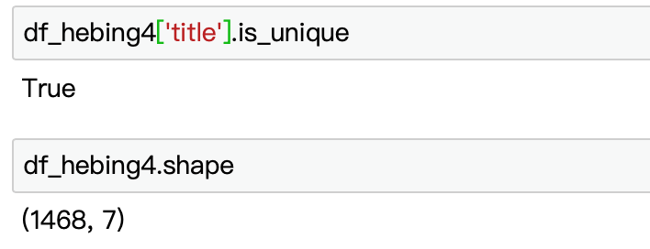
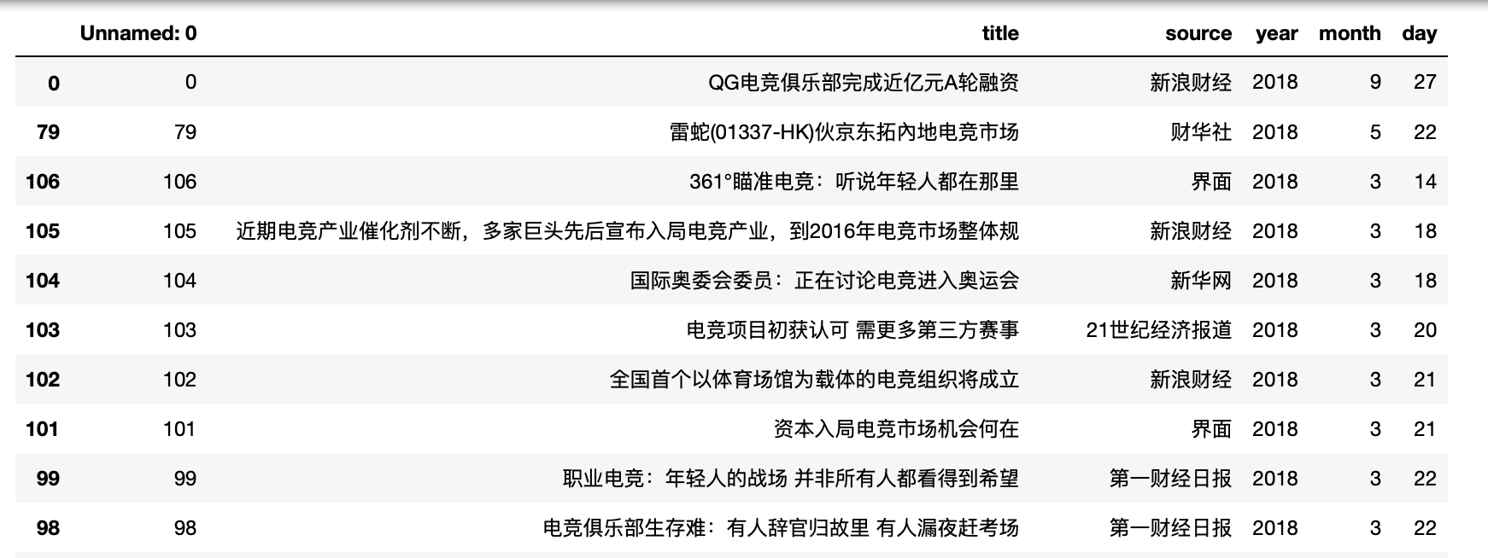
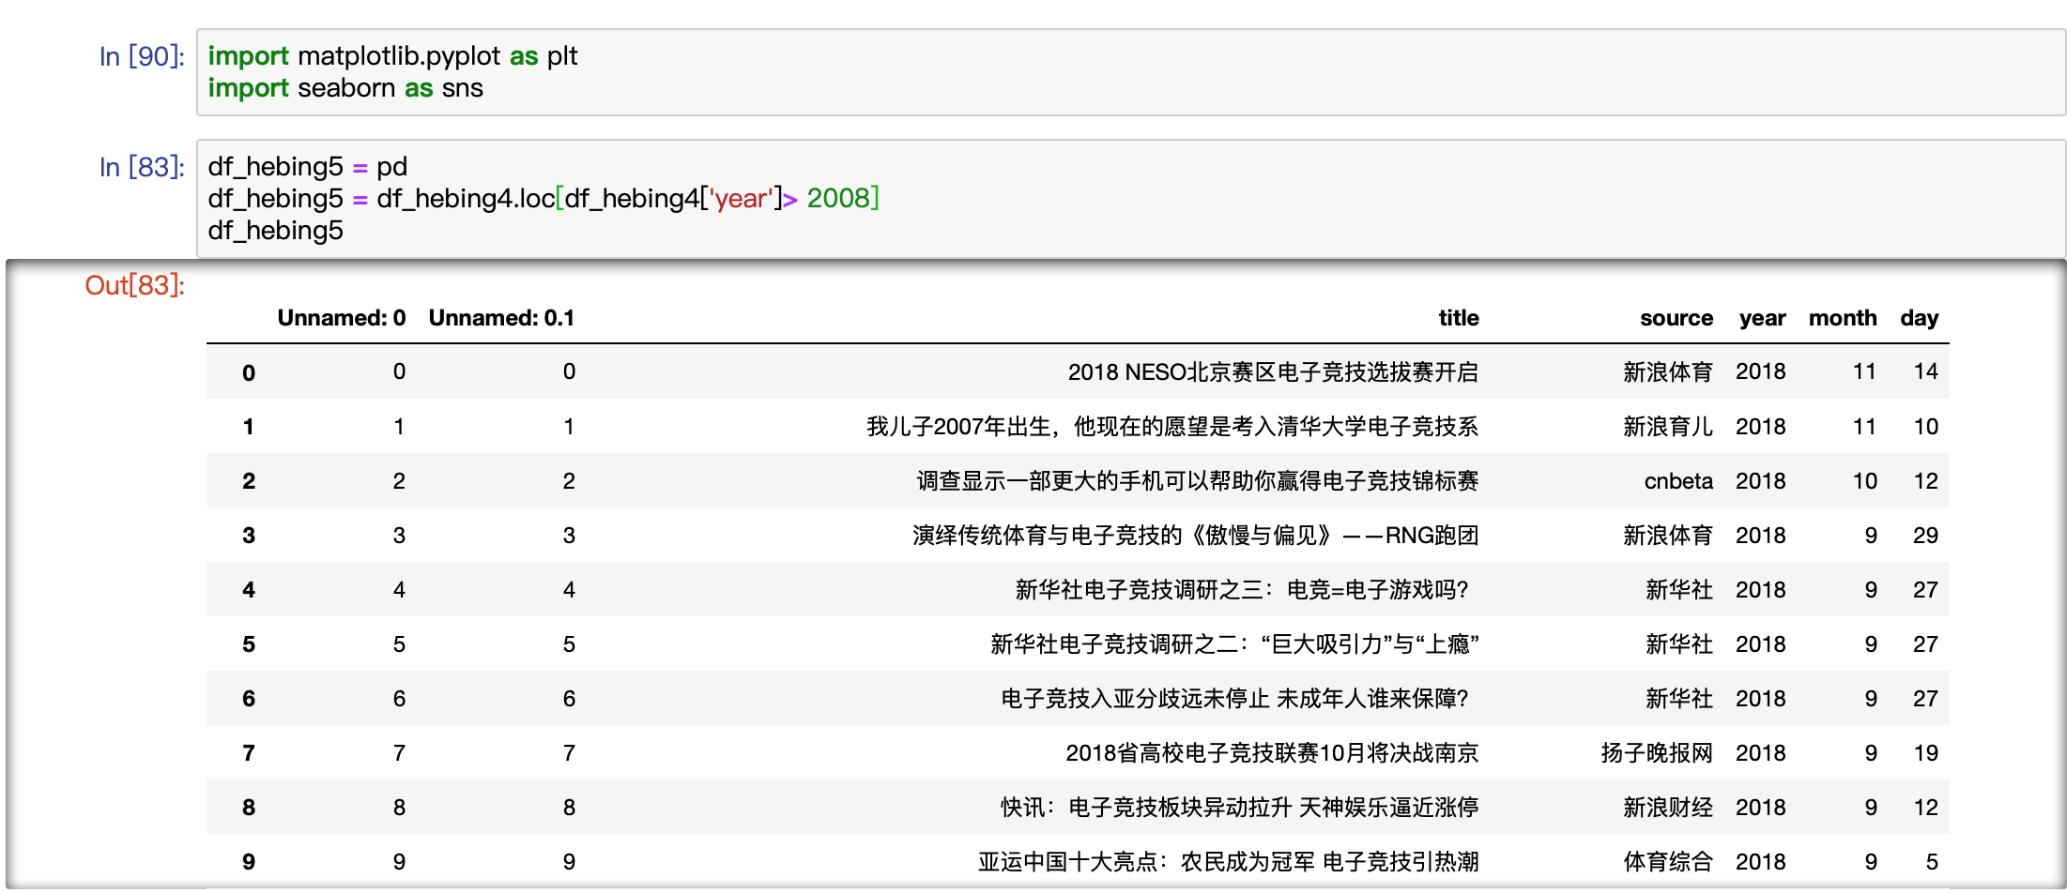
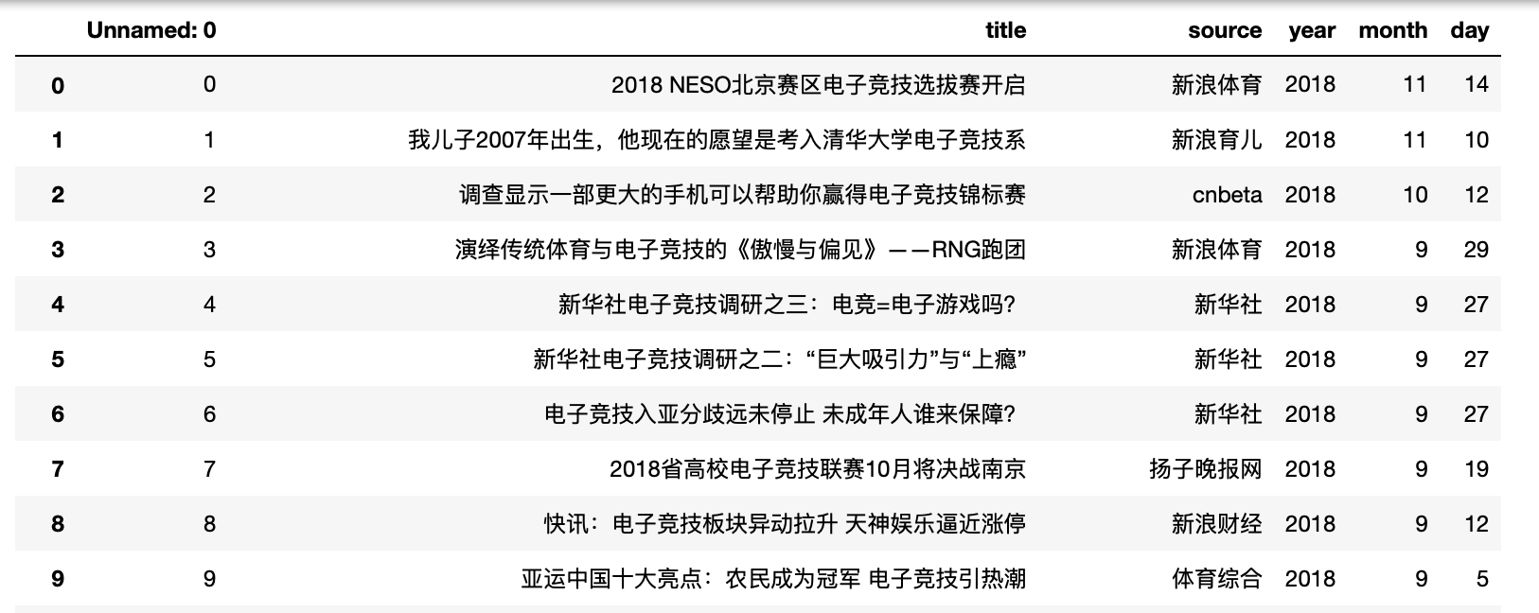
Data Processing
· merge two pandas and drop the duplicated data
· the raw data of sina news（keyword：电竞）
· the data of company information
（keyword：电竞）
（ranged by money）
· the raw data of sina news（keyword：电子竞技）
Notes:
•Procedure (including the trying and debugging process)
–Your understanding of the webpage structure and its techniques
–Your methods to scrape the pages
•What are the major packages?
•What are the major difficulties? How did you solve the problems (you are welcome to spell out the references, or attribute any help from external sources)?
–Your scraped results (the raw dataset)
•What are the data format you stored?
•A screen snapshot of the raw data (in rows and columns), can be csv or Pandas.

Slide 12
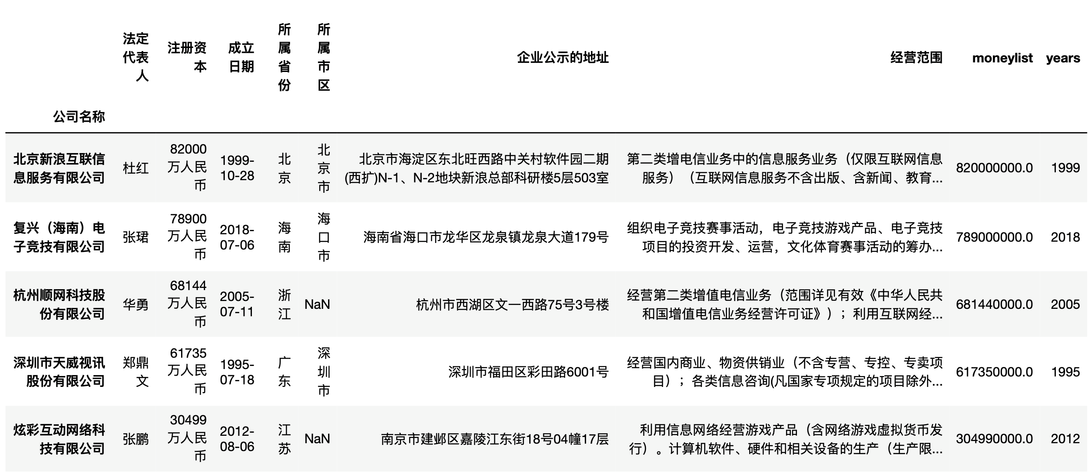
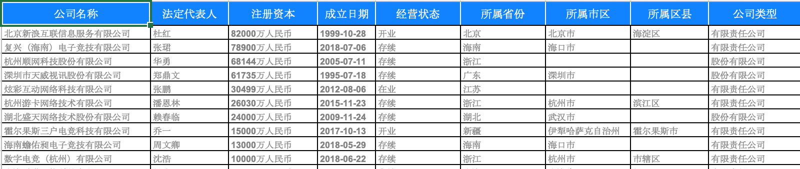
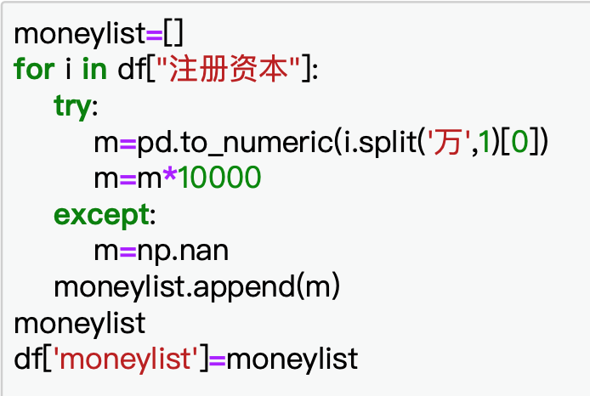
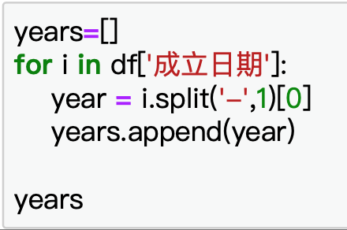
the raw data of company information（keywords：电竞）
excel format/string format
Data Processing
Notes:
•Procedure (including the trying and debugging process)
–Your understanding of the webpage structure and its techniques
–Your methods to scrape the pages
•What are the major packages?
•What are the major difficulties? How did you solve the problems (you are welcome to spell out the references, or attribute any help from external sources)?
–Your scraped results (the raw dataset)
•What are the data format you stored?
•A screen snapshot of the raw data (in rows and columns), can be csv or Pandas.

Slide 13
03
Result

Slide 14

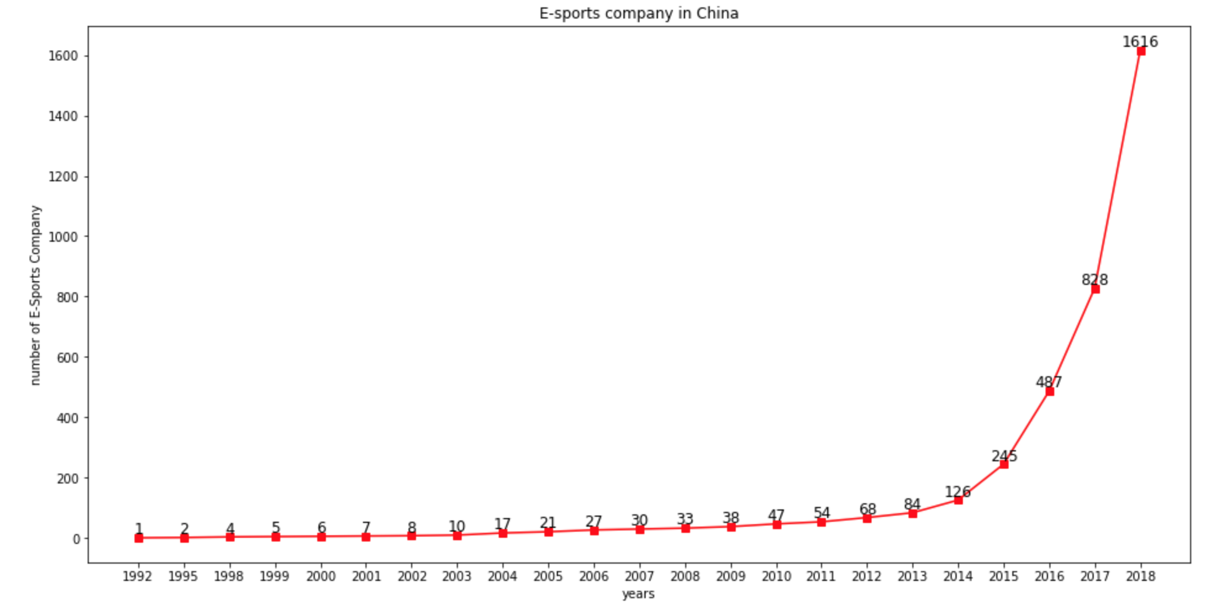
RQ1: What’ the development trend of China’s esports-related companies?

Slide 15
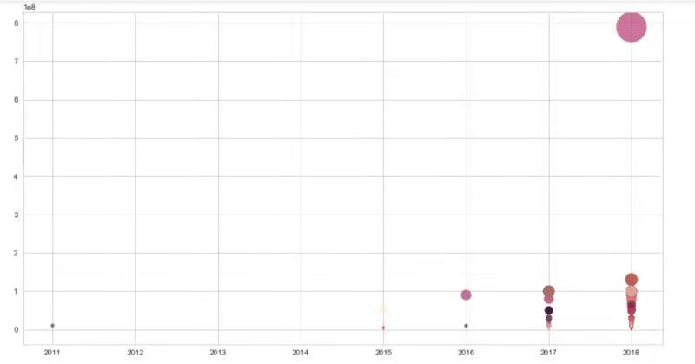
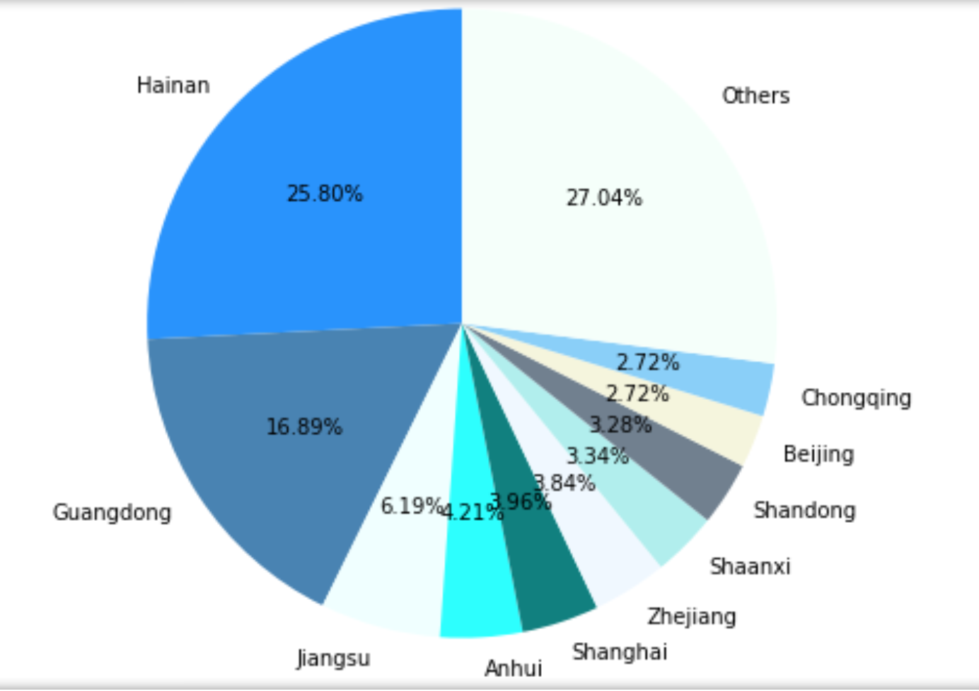
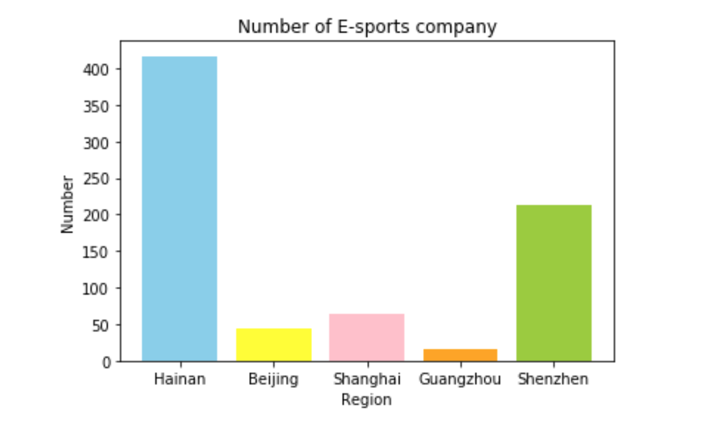
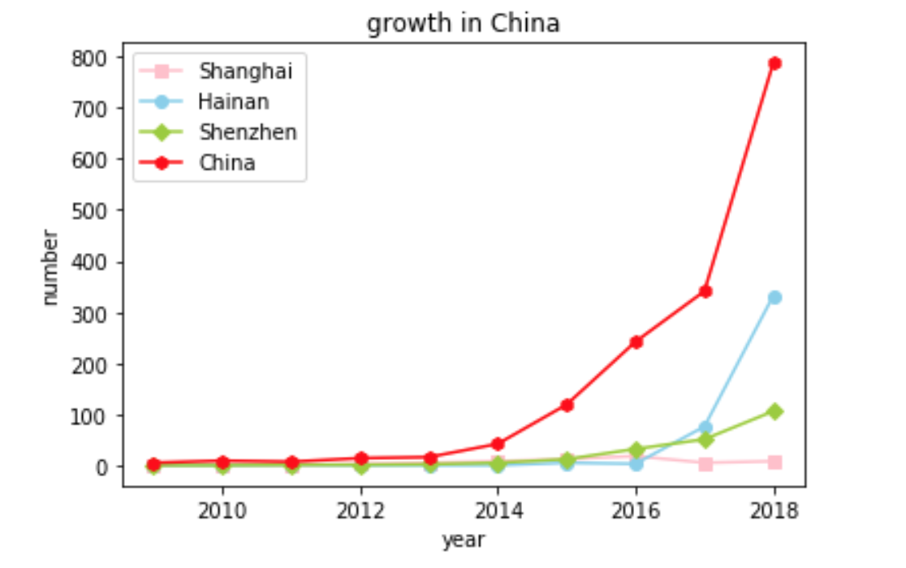
RQ2:What’s the regional distribution of China’s e-sports-related companies?

Slide 16
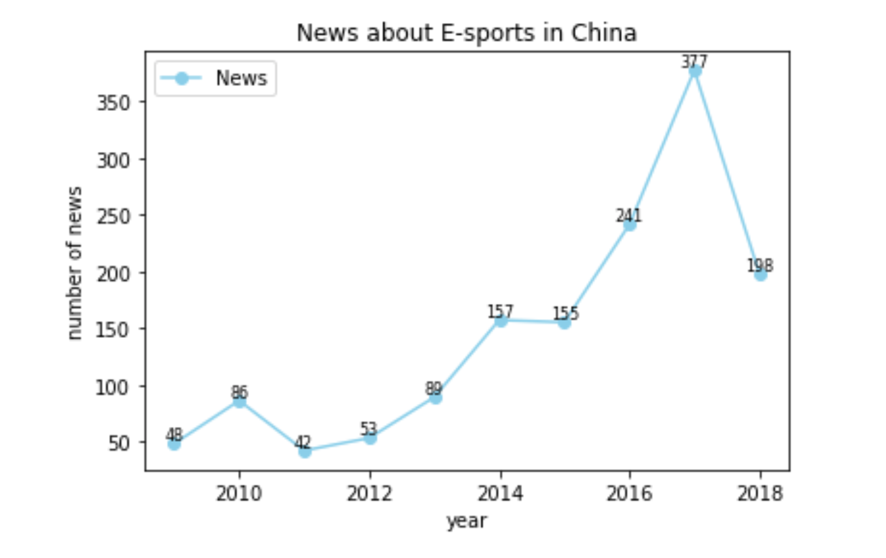
place ：
上海（沪）：26
深圳：14 北京：14
重庆：9 四川：3
海南：1 山东：1
people：
王思聪：21
company：
腾讯：24 阿里：12
暴雪：13
资本：26
discussion：
奥运会：19 亚运会：31
policy：
电竞小镇：9 总局：22
赛事：43
“风口”
“阿里”
“市场”
“概念股”
“文化”
“产业”
“亚运会”
“腾讯”
“赛事”
“大赛”
“义乌”
“万达”
“大赛”
“高校”
“出炉”
RQ3: How news reflects esports in China?

Slide 17
 | China | Shanghai | Hainan
人均地区生产总值 (Per capita GDP) | 56797 | 120567 | 46389
第三产业增加值 (Added value of the tertiary industry) | 405198 | 20223 | 2342
宽带速率 (Network Speed) | 21.2 | 23.85 | 21.71
劳动力占比 (Labor force ratio) | —— | 77% | 72%
高校数量 (Number of colleges and universities) | —— | 53 | 13
Preferential Policy：
Shanghai：
150% pre-tax deduction policy.
Hainan：
Give angel investment (1:1 ratio);
Free office space for 3 years；
RQ4.What factors may relate to regional distribution of esports-related companies？

Slide 18
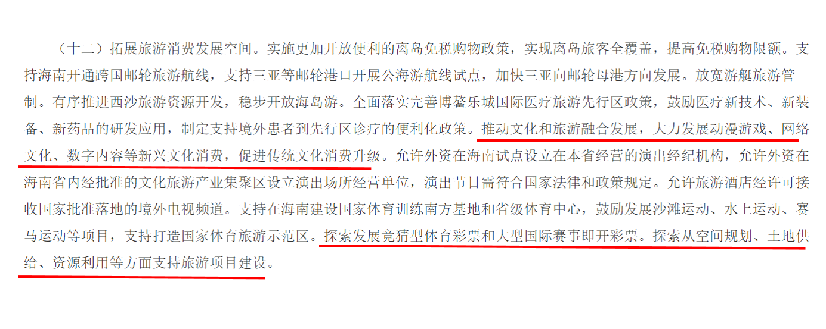
中共中央 国务院
关于支持海南全面深化改革开放的指导意见
（2018年4月11日）
RQ4.What factors may relate to regional distributions of esports-related companies？

Slide 19
THANK YOU

